Slide 1
Basic Linux Commands

Slide 2
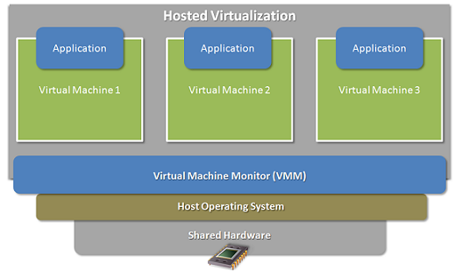
Operating System and VM

Slide 3
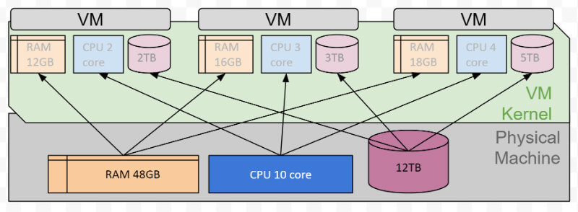
Operating System and VM

Slide 4
Linux file structure

Slide 5
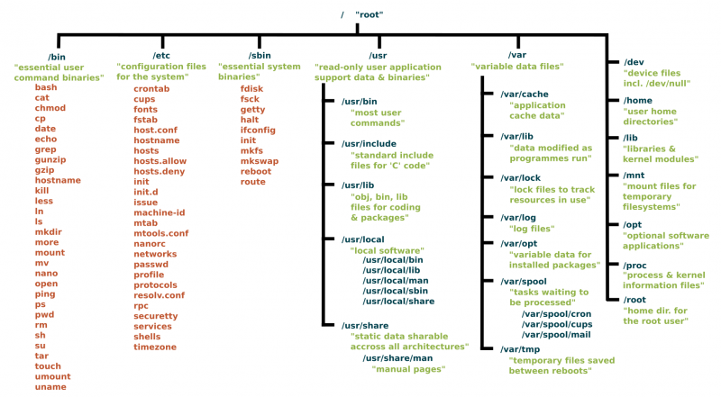
https://www.linux.com/sites/lcom/files/styles/rendered_file/public/standard-unix-filesystem-hierarchy.png?itok=CVqmyk6P

Slide 6
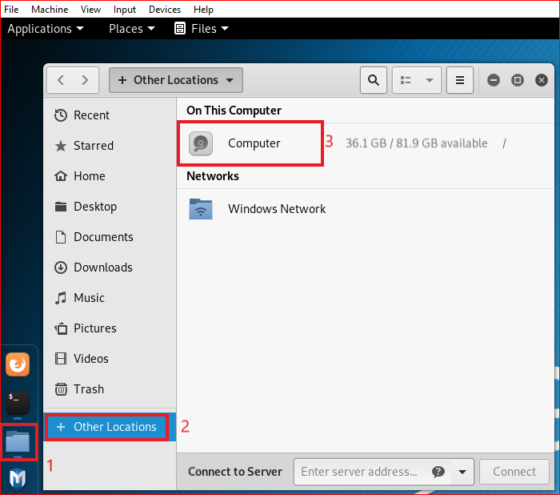
Kali old version

Slide 7
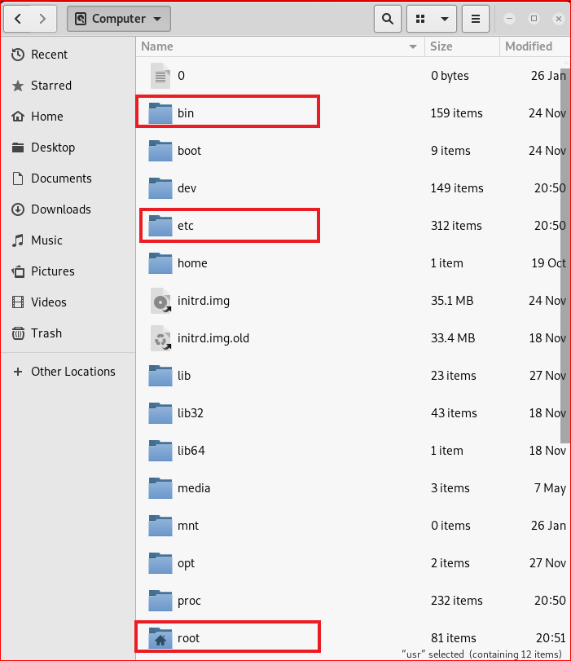
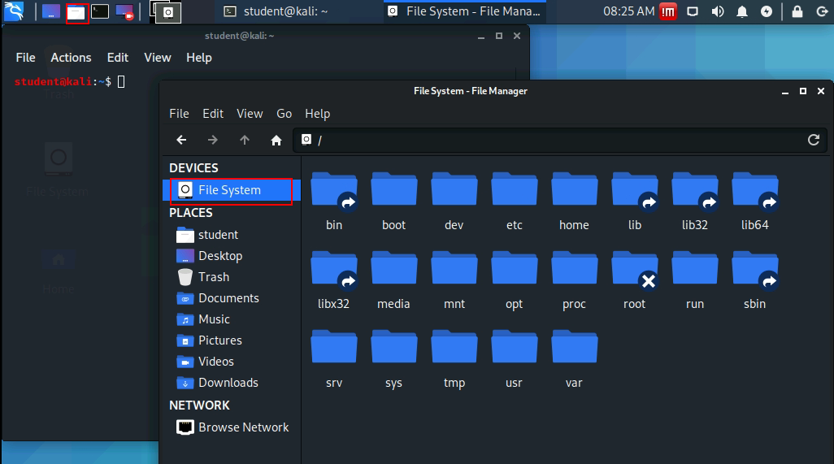
Kali 2020
Kali old version

Slide 8
Folders

Slide 9
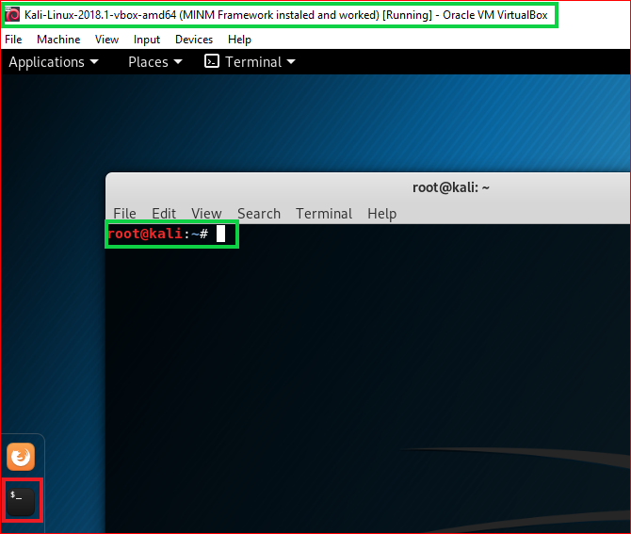

Slide 10
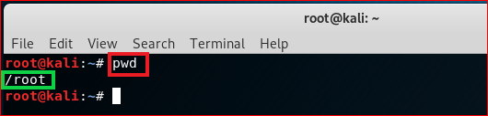
print working directory (pwd)

Slide 11

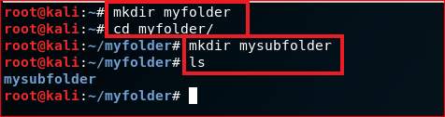
create folders
Root directory
root
\myfolder
\mysubfolder

Slide 12
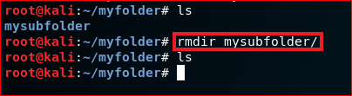
Delete folders

Slide 13
File operations

Slide 14
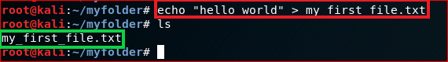
Create a new text file
root
\myfolder
hello world
my_first_file.txt

Slide 15
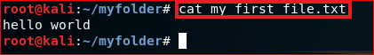
Show the content of the file: cat

Slide 16
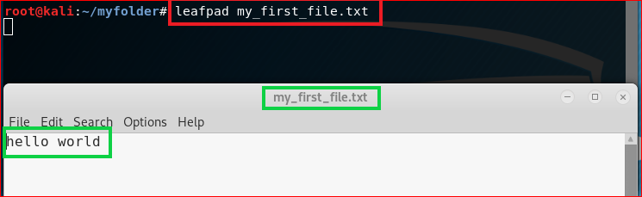
Show the content of the file

Slide 17
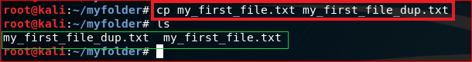
Copy (cp) a file

Slide 18
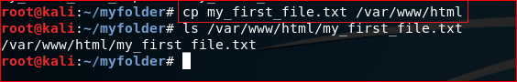
Copy (cp) a file to a different location

Slide 19
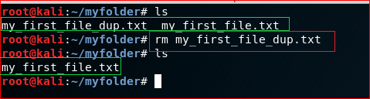
Remove a file: rm

Slide 20
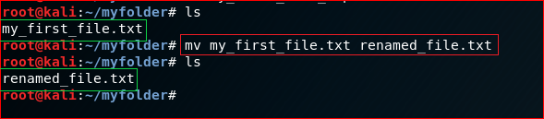
Rename a file (mv)

Slide 21
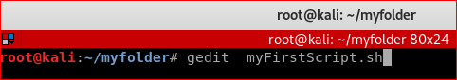
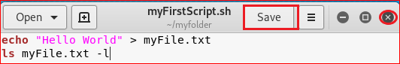
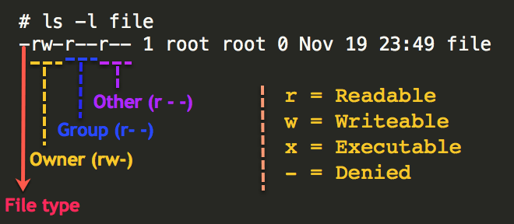
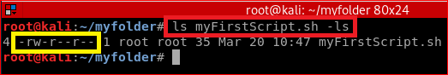
Create a simple script file

Slide 22
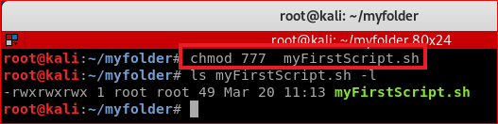
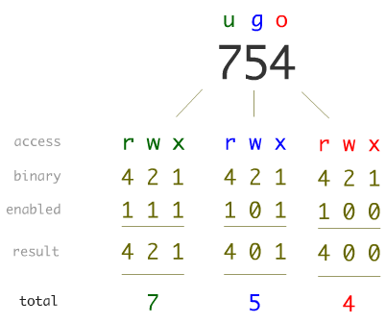
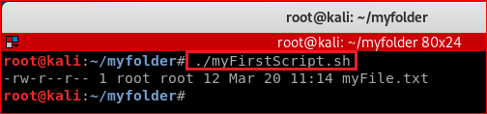
Linux Permissions

Slide 23
Networking

Slide 24
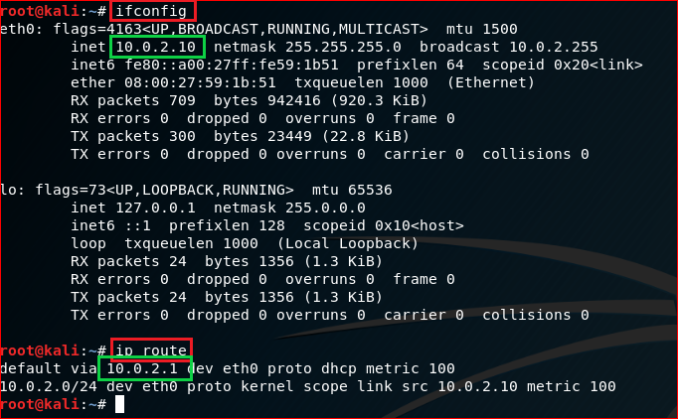
IP default gateway

Slide 25
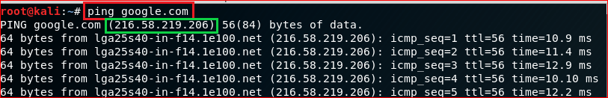
Test network connection using domain name

Slide 26
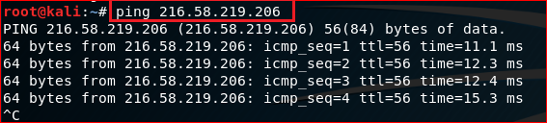
Test network connection using IP

Slide 27
Download files

Slide 28
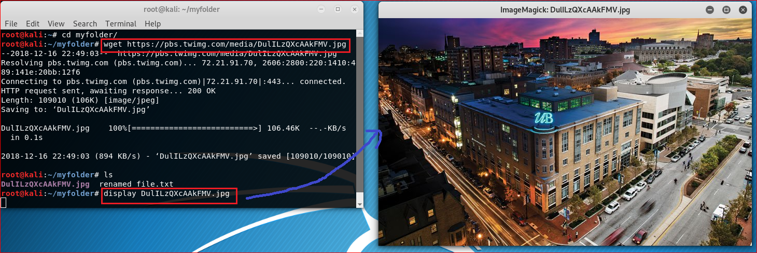
https://pbs.twimg.com/media/DulILzQXcAAkFMV.jpg

Slide 29
Update/Install software

Slide 30
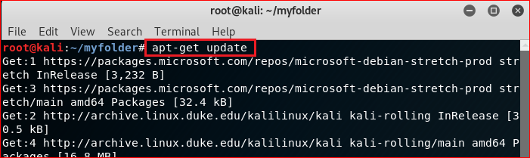
Update software

Slide 31
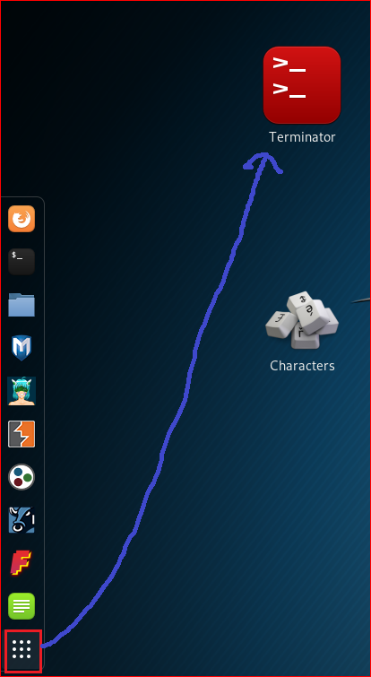
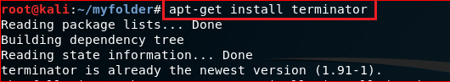
Install terminator

Slide 32
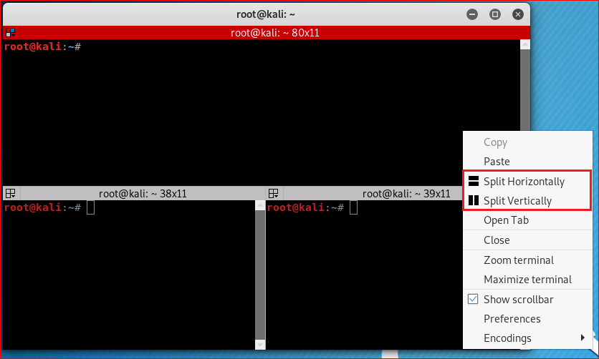

Slide 33
Compress files

Slide 34
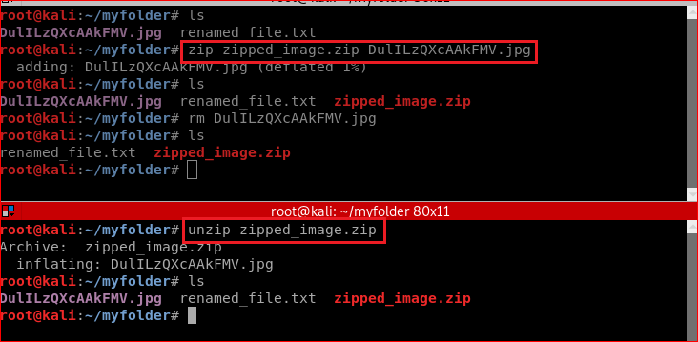
Zip/unzip files

Slide 35
Reference
https://www.linux.com/blog/learn/intro-to-linux/2018/4/linux-filesystem-explained

